Slide 1
Twitter Analytics
Eric Newsom
Keifer Laverty
Devon moses

Slide 2
Agenda
Project Overview
Requirements
Design Decisions
Spiral 1
Spiral 2
Spiral 3
Moving Forward
Demo

Slide 3
Project Overview
Search for tweets and store into our database.
Our projected user base is businesses or individuals that desire to improve their social media presence.
We will accomplish this by providing a platform for them to analyze their own Twitter usage and trends in consumer interests.

Slide 4
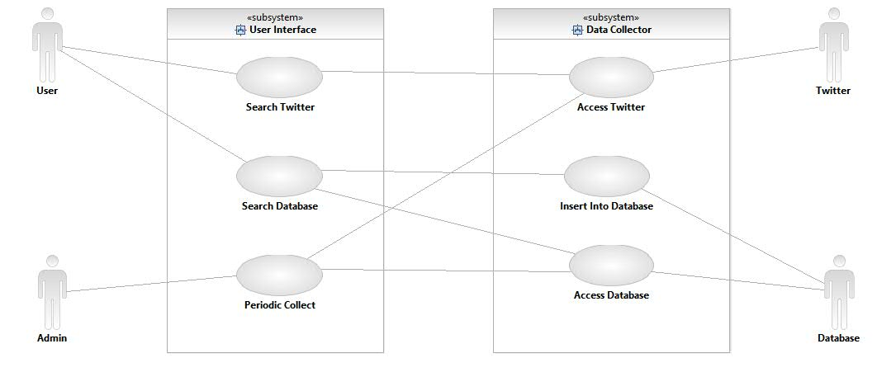
Use Case Diagram

Slide 5
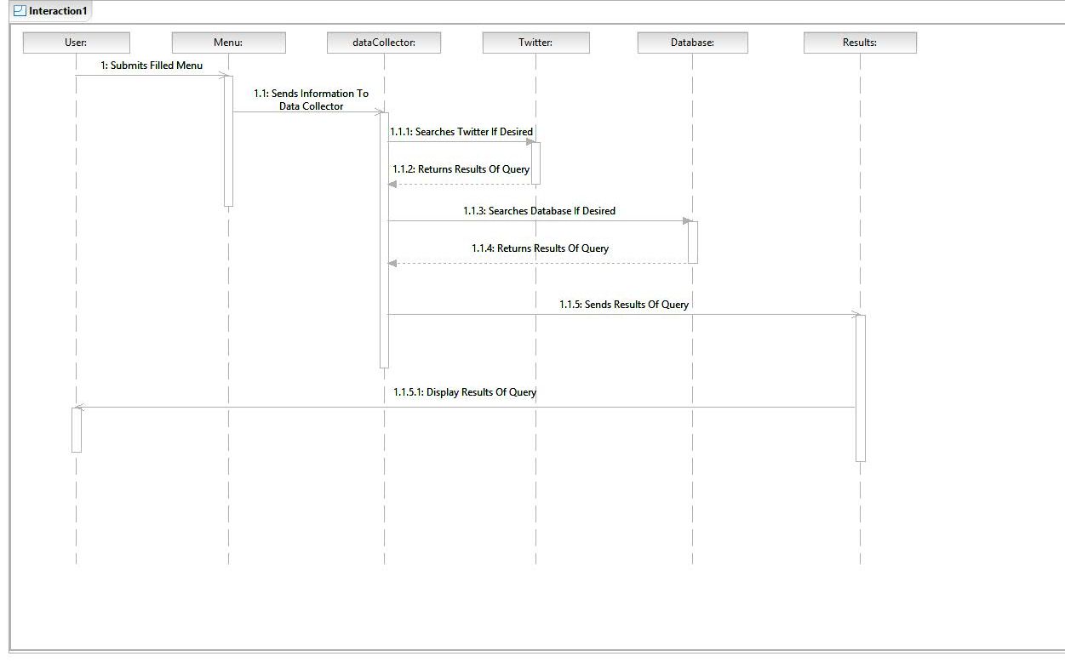
Sequence Diagram

Slide 6
Spiral Design Methodology
Pros | Cons
Allows for maximum features in the allotted time frame. | Spirals may continue indefinitely.
Can accommodate changing requirements. | Large number of spirals requires many versions and much documentation.
Working versions at the end of every cycle.
Easily allows for modular testing.

Slide 7
Overall Functional Requirements
Inputs
A desired phrase or username to search for.
The desired set of data to search from.
The desired amount of tweets to be returned.
Desired search filters. (e.g. No Replies, No Profanity, etc.)

Slide 8
Overall Functional Requirements
Transformations
Search Twitter or Database for desired phrase or username.
Transform the datatypes returned by Twitter/Database into our common data structure.
Assign profanity flags to each tweet.

Slide 9
Overall Functional Requirements
Outputs
Displays the tweets returned from Twitter or our database in an organized table.
Organize data collected into visual representations depending on user preferences.

Slide 10
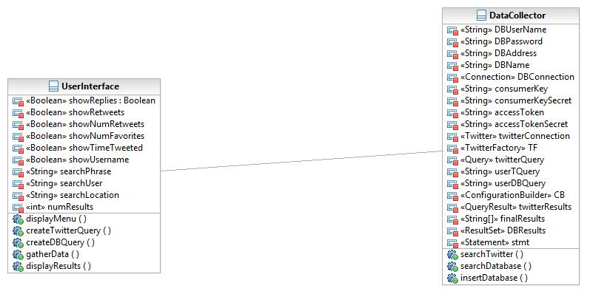
First Class Diagram

Slide 11
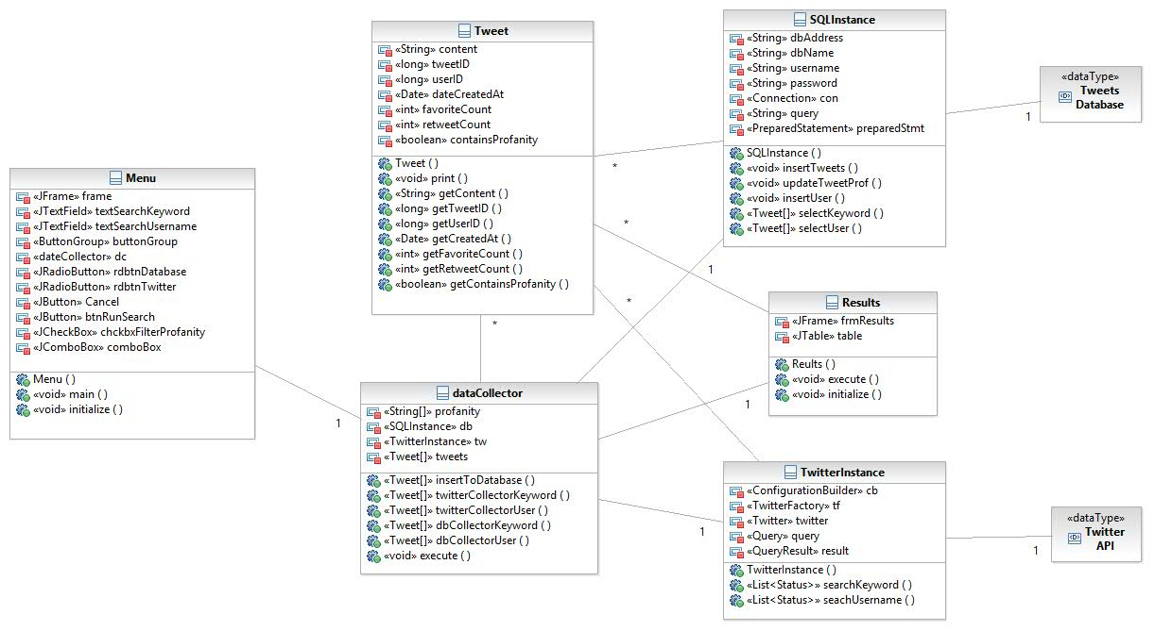
Updated Class Diagram

Slide 12
Requirement Priorities
We determined that with the allotted time frame we should assign priorities to the functional requirements we desired to implement.
Priorities were assigned based on what we believed was necessary for execution, as well as what was technically feasible.

Slide 13
Requirement Priorities
Highest | Middle | Lowest
Twitter and Database Connections. | Storing collected tweets into database. | Data Visualization.
Query Creation. | GUI Creation for inputs. | Search by date.
Profanity Filtering. | Display results of queries. | Generate data reports.

Slide 14
Overall Design Decisions
Why Java?
We believed that we would benefit from the Object-Oriented nature of Java.
This allowed us to create our own tweet object for uniformity across the application.
We also had prior experience with Java and more specifically the twitter4j library and the JDBC library used for connections to Twitter and Databases.

Slide 15
Overall Design Decisions
Why Amazon Web Services?
We desired a platform that would be free of cost as we will only be utilizing it for 3 months.
Of all the free SQL databases AWS provided the most disk space.
We chose to use a relational SQL database because we have prior experience working with them.

Slide 16
Spiral 1
Requirements
Setup connections to twitter and the database.
Search Twitter and Database by keyword.
Allow insertion of results from twitter into the database.

Slide 17
Spiral 1
Design
We decided to design three classes in the first spiral.
TwitterInstance is a class that establishes a connection to Twitter and allows the submission of queries.
SQLInstance is a class that establishes a connection to our database and allows insertion and selection of tweets
dataCollector is a class that utilizes TwitterInstance and SQLInstance to collect and move data between the two.

Slide 18
Spiral 1
Design
In our database we decided to have a Tweets tables to store content and information about tweets and a Users table to store users and information about them in the future.

Slide 19
Spiral 1
Evaluation
We performed unit testing on the first spiral by utilizing dataCollector as our “dummy main” and testing the functionality of TwitterInstance and SQLInstance.
Query results from Twitter were slow and made us consider speed up options in the future.
Twitter4J and JDBC had different structures for returning data, therefore we needed a uniform object for tweets.
Realized that profanity was an issue and needed to come up with a way to filter tweets containing profanity.

Slide 20
Spiral 2
Requirements
Creation of a Menu to easily test upcoming features.
Implement a basic profanity filter to allow flagging of tweets containing profanity.
Creation of a tweet object to be uniformly used throughout the program.
Implement search by username for Twitter and Database.

Slide 21
Spiral 2
Design
We desired a User Interface that allowed for input of keyword, username, desired number of results, data to search from, and filtering profanity.
We needed a list of profane words to check the contents of the tweets against.
A tweet object that stored information about a tweet in a uniform matter that could be utilized in both TwitterInstance and SQLInstance.

Slide 22
Spiral 2
Implementation
We utilized Eclipse’s Window Builder plug-in to create the User Interface we desired.
We created an array of profane words that we could iterate through and check for the presence of each word in the content of our tweets.

Slide 23
Spiral 2
Evaluation
The implementation of a Tweet object was very beneficial to the execution of the rest of our application.
We also realized that implementing an efficient and effective profanity filter isn’t feasible in our timeframe.
With evolution of our profanity filter we needed a function to update profanity flags in the database.

Slide 24
Spiral 3
Requirements
Generate a table of tweets from our search queries.
Create a function to update profanity flags of tweets stored in the database.

Slide 25
Spiral 3
Design
We needed a dynamic table that could hold 0 – 100 tweets with resizable columns.
The function used to update profanity flags needed to gather all tweets and check them against the most recent profanity filter.

Slide 26
Spiral 3
Implementation
We used a Jtable within a scroll pane to generate a dynamic table that also had resizing functionality.

Slide 27
Spiral 3
Evaluation
Updating all tweets stored in database is a cumbersome process and needed a more efficient implementation.

Slide 28
Moving Forward
Add search by date functionality.
Implement and update function to periodically update all stored tweets retweet and favorite counts.
Implement a function to check whether stored tweets are still active.
Add more analyzation and visualization tools.
Add a function to periodically collect data.

Slide 29
DEMO

